Slide 1
MOBILE PROGAMMING

Slide 2
Kelompok 1 :
Vivie Salma steviana
Adam Ramdhan
Rozy Alfadi
Hadi Rachmat Supindar

Slide 3
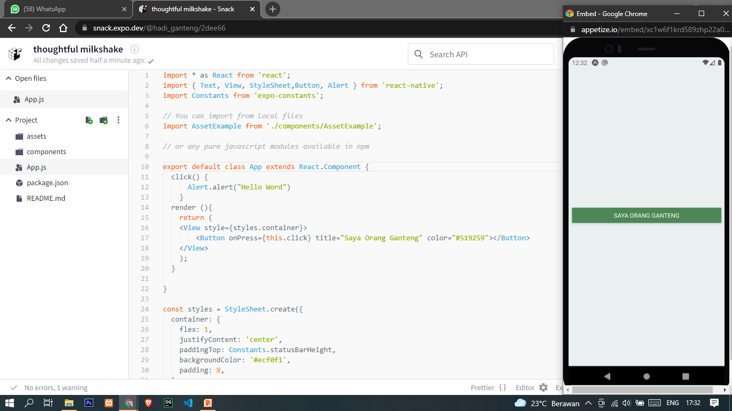
expo.dev

Slide 4
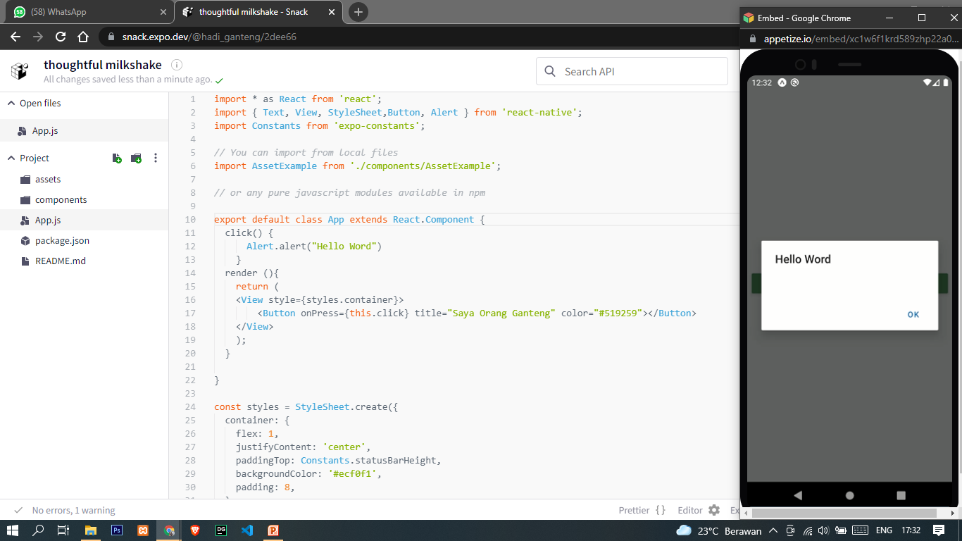
expo.dev

Slide 5
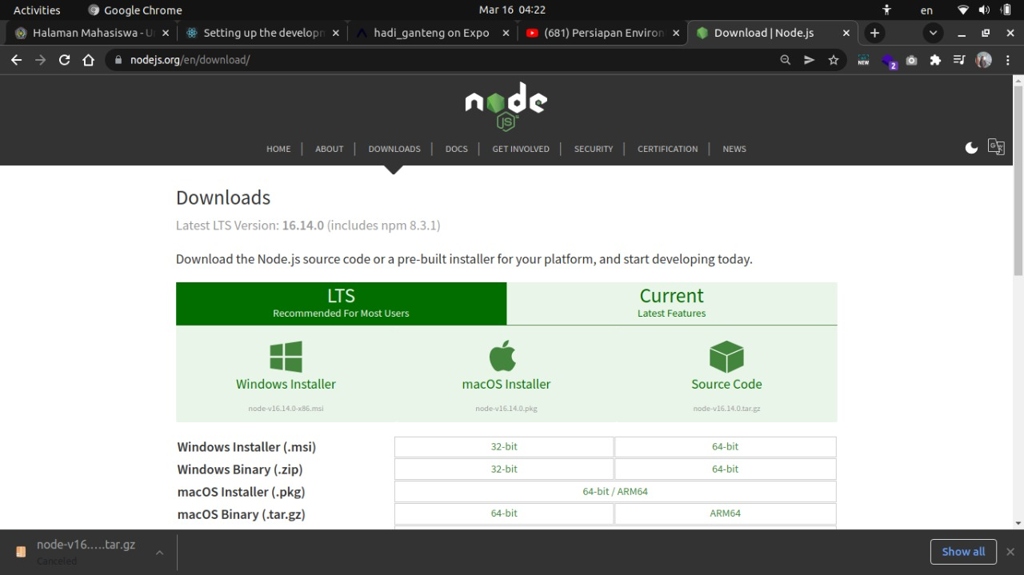
NODE JS

Slide 6
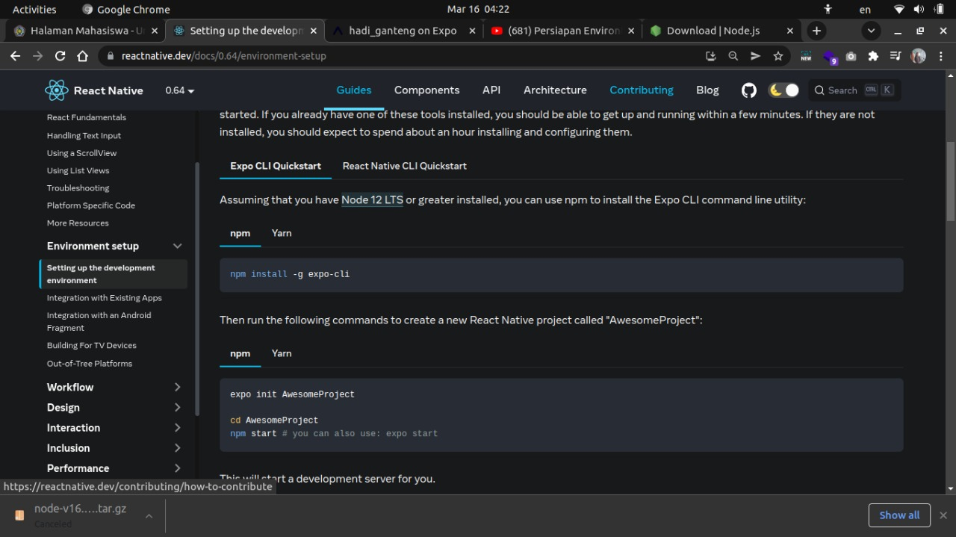
React Native

Slide 7
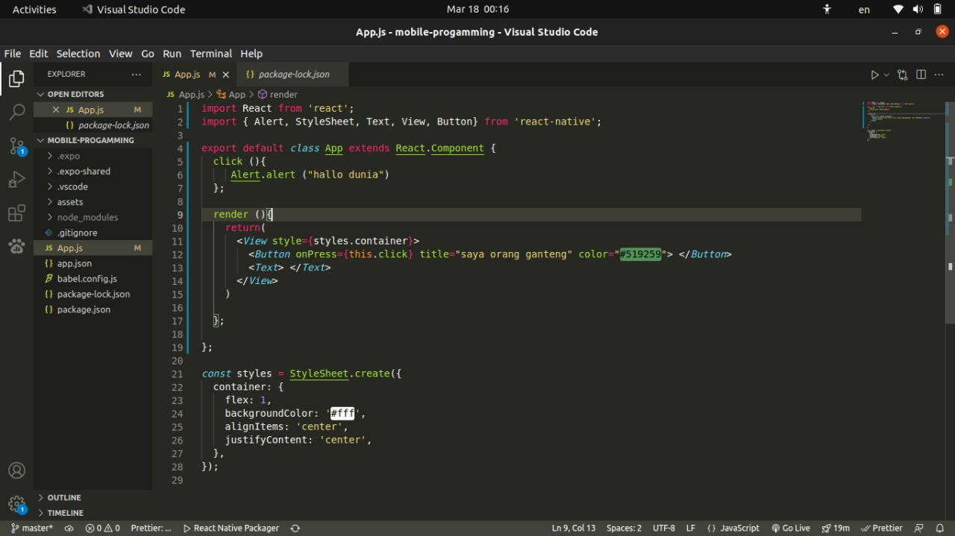
Source code

